Slide 1
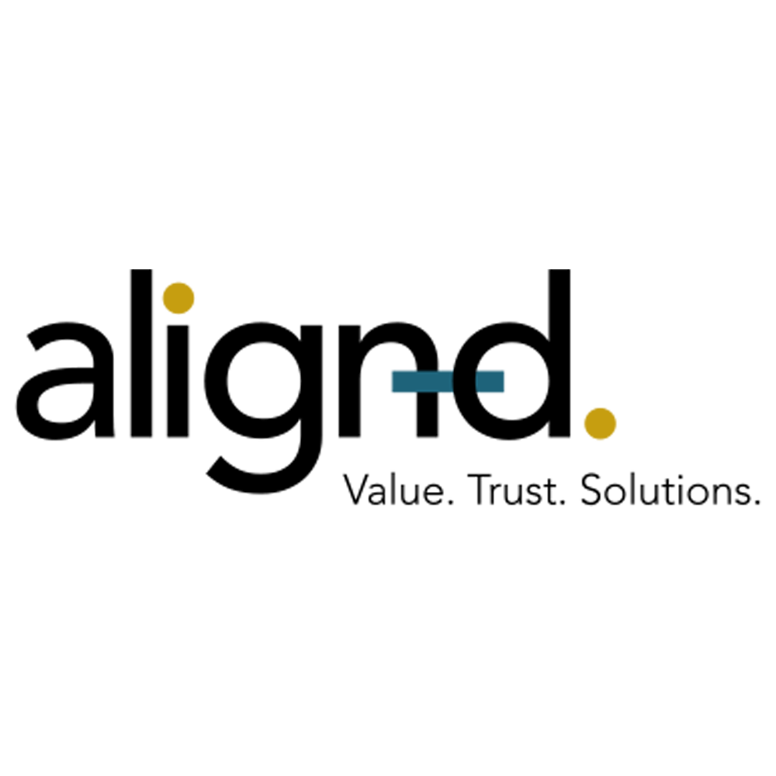
D Gukwe
Client Analysis

Slide 2
Demographic_Overview
Majority of the clients are Males 57% , Females 43%
LP (Limpompo Province) likely has the highest avg income. NC or NW typically have lower averages.
The dominating clients are Families or Couples
Generally, Couples have the highest average income, followed by Families, with Singles typically earning less.
Key Takeaway : High-income provinces are better targets for premium products; lower-income ones for entry-level options

Slide 3
Product and Premium Insights
Income generally increases with the number of products, indicating individual with higher income are more likely to have more products
Certain age groups (e.g. late 30s to 50s) likely show higher average products—these are probably financially active clients.
Family clients contribute most to total premium volumes, followed by couples, then singles.
Premium amounts increase with client duration—clients who stay longer tend to invest more.
Key Takeaways: Singles mostly purchase only single_premium (as expected), whereas families and couples contribute across multiple premium types.Mid-age, mid-to-high income clients hold more products

Slide 4
Lapse Rate & Retention
Lowest lapse rates are seen in Western Cape (WC) and Gauteng (GP) where highest lapse rates are seen in Limpopo (LP) and North West (NW)
Capitec and FNB clients seem to have relatively lower lapse rates.
Lapse rates tend to decrease as the number of products increases, although there is some fluctuation beyond 5 products.
Males and females have similar lapse rates, with a very slight edge towards higher lapses among males.
Key Takeaway : Strong cross-sell (multiple product ownership) is correlated with higher retention. This suggests bundling or loyalty strategies might be effective. Provinces like WC and GP show stronger retention.

Slide 5
Geographic and Payment behavior
Limpopo and Eastern Cape—often considered lower-income regions—show high average incomes here.
Most popular banks among clients are Capitec, followed by FNB and ABSA.
Clients from Capitec and Nedbank have the highest average product holdings.
Highest client counts are in Gauteng (GP) and Western Cape (WC) .Lower client volumes in Northern Cape (NC), North West (NW)
Key Takeaway : Market size is largest in urban hubs (GP, WC). More products often correlate with customer stickiness. Capitec and Nedbank clients might be more loyal and engaged.

Slide 6
Thank you

